Slide 1

BE Semester VII: Project Presentation
Detection of Pneumonia in Chest X-Ray using Transfer Learning based approach
Presented by
Zuber Ansari – 57
Gaurav Bavdane – 59
Neha Bhujbal – 61
Nameera Shaikh – 72
Under the guidance
of
Ms. Pallavi Patil
Department of Electronics and Telecommunication Engineering
St. Francis Institute of Technology, Mumbai

Slide 2
Contents
Introduction
Motivation
Problem Statement with objectives
Literature Review
Proposed work /Design
Software/Hardware Requirements
Results & Discussions
Applications
Conclusion
References

Slide 3
Motivation
Conventional Orthodox behind ML approach
Same feature space
Same distribution
Not Last Approaching real world application + uncertainty a common syndrome
Example - Covid19
Source of virus
Symptoms of Covid19
Is there any variant ?
“
Data availability
Transfer Learning
Suppose you have cancer and you have to choose between a black box AI surgeon that cannot explain how it works but has a 90% cure rate and a human surgeon with an 80% cure rate . Do you want the AI Surgeon to be illegal ?
-- Geoffrey Hinton
(Father of Modern Deep Learning)
Knowledge Transfer
Improves performance
“

Slide 4
Problem Statement Objective
Chest X-Ray Images(Pneumonia) provided us with chest X-ray images, which was originally published by Mendeley Data in association with Elsevier.
Dataset is organized into 3 folders (train, test, val) and contains subfolders for each image category. There are 5,856 X-Ray images (JPEG) and 2 categories (Pneumonia/ Normal).
The train set contains 1341 Normal and 3875 Pneumonia X-Ray images, the val set contains 8 Normal and 8 Pneumonia X-Ray images and the test set contains 234 Normal and 390 Pneumonia X-Ray images respectively.
Our project aims at using Deep Convolutional Neural Networks to detect pneumonia in Chest X-Ray using Transfer Learning.
“The desired deep learning technique aims to detect any abnormality in lungs due to Pneumonia using Chest X-ray images.”

Slide 5
Literature Review
Reference Papers: -
Pneumonia Detection using CNN as Feature Extractor [1]
Study of different CNN models for feature extraction
Methodology consists of 3 stages: Pre-processing, Feature extraction and Classification Stage
Final AUC Score = 0.8002
2. Chest X-ray Disease Diagnosis with Deep Convolutional Neural Networks [2]
Development of multi-label CNN to Localize the 14 thoracic pathologies
Implemented Simple FFN, didn’t perform well w.r.t AUC Score
3. Abnormality Detection and Localization in Chest X-Rays using DCNN [3]
Trained different DCNN Localization and detection of different abnormalities in chest X-Rays
Same DCN architecture provides inconsistent results for other abnormalities.

Slide 6
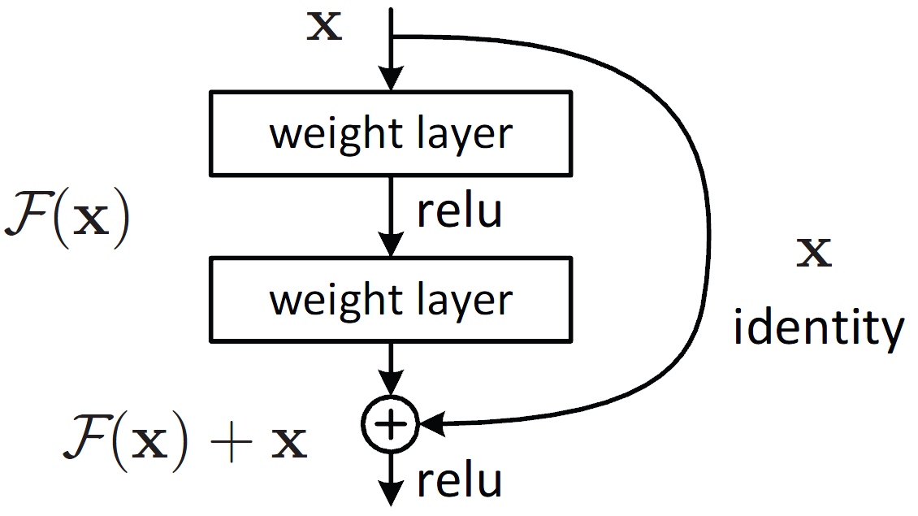
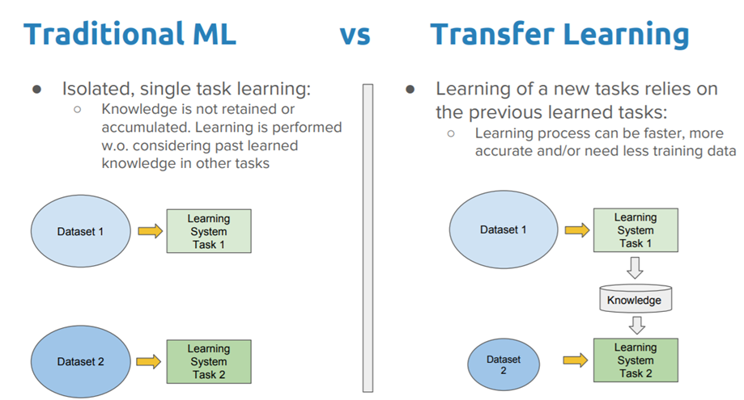
Proposed Work
Technique used - ResNet50 + Transfer Learning
ResNet50 architecture is robust.
Fig 1
Transfer Learning over pre-trained ResNet50 from ImageNet
Gives us State-of-the-art results
Reduces computational and time complexities
Fig 2
Approaches to Transfer Learning
Feature Extraction
Fine tuning

Slide 7
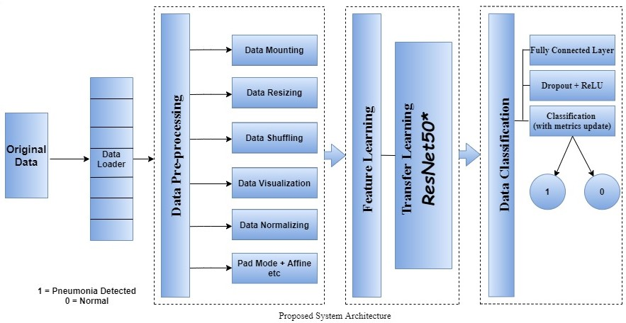
Proposed System Architecture
Fig 3

Slide 8

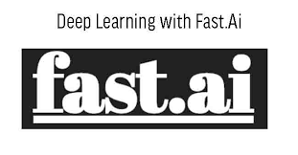



Software Requirements
Python
fastai [4]
PyTorch
Google Collaboratory
Kaggle

Slide 9
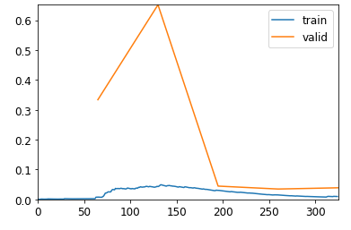
Results
In Fig 3, the data is converted into data loader which then passes through Classification process for evaluation purpose.
The train loss vs validation loss graph converges which indicates the authenticity of the model.
loss
The loss function used is cross-entropy loss.
batches

Slide 10
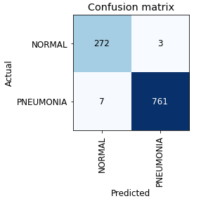
Results
The Metrics used for evaluation purpose are:
Metric | Score
Error Rate (ER) = (FN + FP)/Total | 0.0096
Accuracy = 1 - ER | 0.9904
Precision (P) = TP/(TP + FP) | 0.9961
Recall (R) = TP/(TP + FN) | 0.9909
F1 Score = 2PR/(P + R) | 0.9935
Fig 5
TP = True Positive
FP = False Positive
FN = False Negative

Slide 11
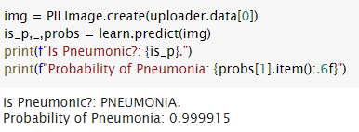
Results
The Testing of model is done by,
Utilising any random JPEG image:

Slide 12
Applications
Can be used in remote areas to detect the thoracic disease without any delay due to this automated system.
Also the computational complexities and time complexities are reduced due to the use of transfer learning which gives better prediction faster.
The development of algorithms in this domain can be highly beneficial for providing better health-care services.
Notes:
hello hii

Slide 13
Conclusion
An efficient model for classifying the chest X-Ray images with high level of classification accuracy(0.9904) was designed.
To increase the robustness of the classifier, we employed the Transfer Learning of the powerful ResNet-50 CNN pretrained on ImageNet.
The developed model makes use of “Chest X-Ray Images(Pneumonia)” dataset with 80% of the images used for training and 20% used for validation.
Indeed, the proposed work provides a comprehensive model for medical image processing/classification from input layer to the output layer.

Slide 14
References
Dimpy Varshni, Kartik Thakral, Lucky Agarwal, Rahul Nijhawan, Ankush Mittal, “Pneumonia Detection Using CNN based Feature Extraction”, 2019 IEEE International Conference on Electrical, Computer and Communication Technologies (ICECCT), Coimbatore, India, DOI 10.1109/ICECCT.2019.8869364
Christine Herlihy, Charity Hilton, Kausar Mukadam, “Chest X-ray Disease Diagnosis with Deep Convolutional Neural Networks”,2019, https://crherlihy.github.io/project/chestxray/cse6250_final_report.pdf
Mohammad Tariqul Islam, Md Abdul Aowal, Ahmed Tahseen Minhaz, Khalid Ashraf , “Abnormality Detection and Localization in Chest X-Rays using Deep Convolutional Neural Networks”, arXiv:1705.09850v3, Sept 2017
Jeremy Howard, Sylvain Gugger , "fastai: A Layered API for Deep Learning", arXiv:2002.04688
https://pytorch.org/hub/pytorch_vision_densenet/
https://towardsdatascience.com/residual-blocks-building-blocks-of-resnet-fd90ca15d6ec

Slide 15
Thank you

